Slide 1
Hyperledger, CI/CD and big data
High available, scalable blockchain as service
云图智链
谢文杰
2017-03-04

Slide 2
About us
国内最早一批研究区块链(BlockChain)商业模型和底层核心技术的团队。
提供FinTech、云计算、移动互联网等多领域的核心技术服务。

Slide 3
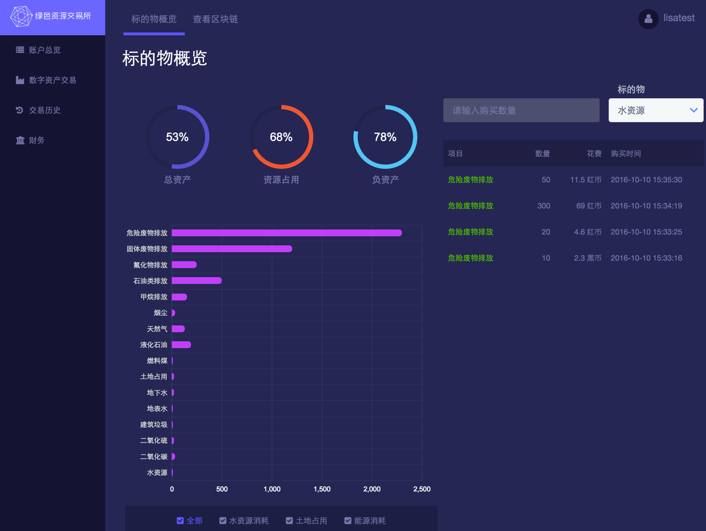
Cases

Slide 4






Hyperledger and blockchain
Specialization
Efficiency
Equality
Generalization
Notes:
For enterprise

Slide 5


Hyperledger and CI/CD
Interface
Service
Chaincode
Notes:
Do not need to discuss why CI/CD.
Benefits such as Make code stable, Less time deploying, Solve problems quickly.
Difference from traditional CI/CD is the chaincode.

Slide 6
Hyperledger and big data
Real-time streaming
IBM StreamBase, Apache Storm, Amazon Kinesis, ...
Blockchain
HBase, Cassandra, …
Data Warehouse
MapReduce, Cluster Computing, ...
Distributed Computing

Slide 7
High availability
Load Balancers
Load Balancers
Blockchain HA
Service
Hyperledger Peer
Containers
Containers
Service HA
Docker Orchestration
Notes:
Blockchain Native HA
Warm up

Slide 8
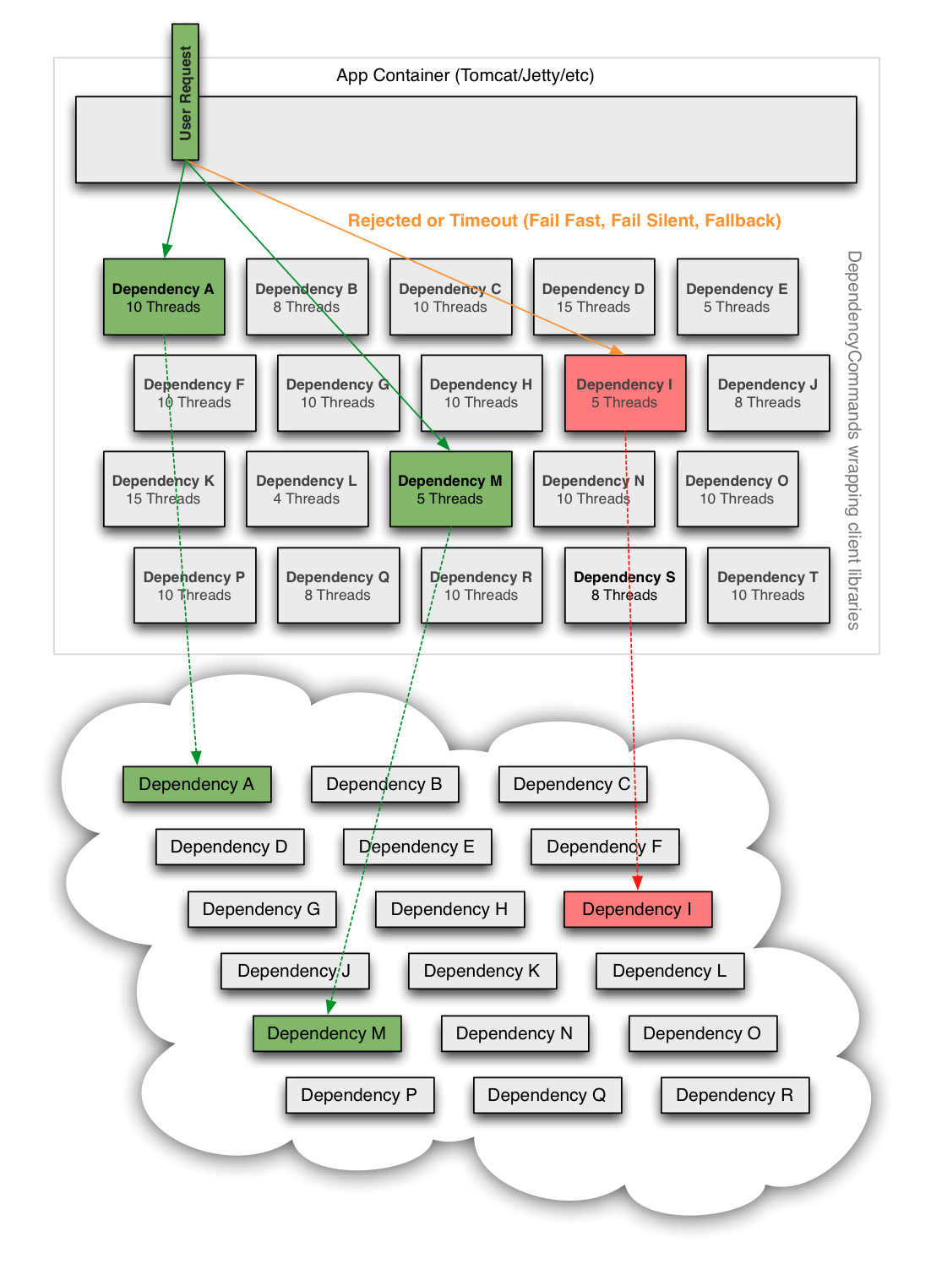
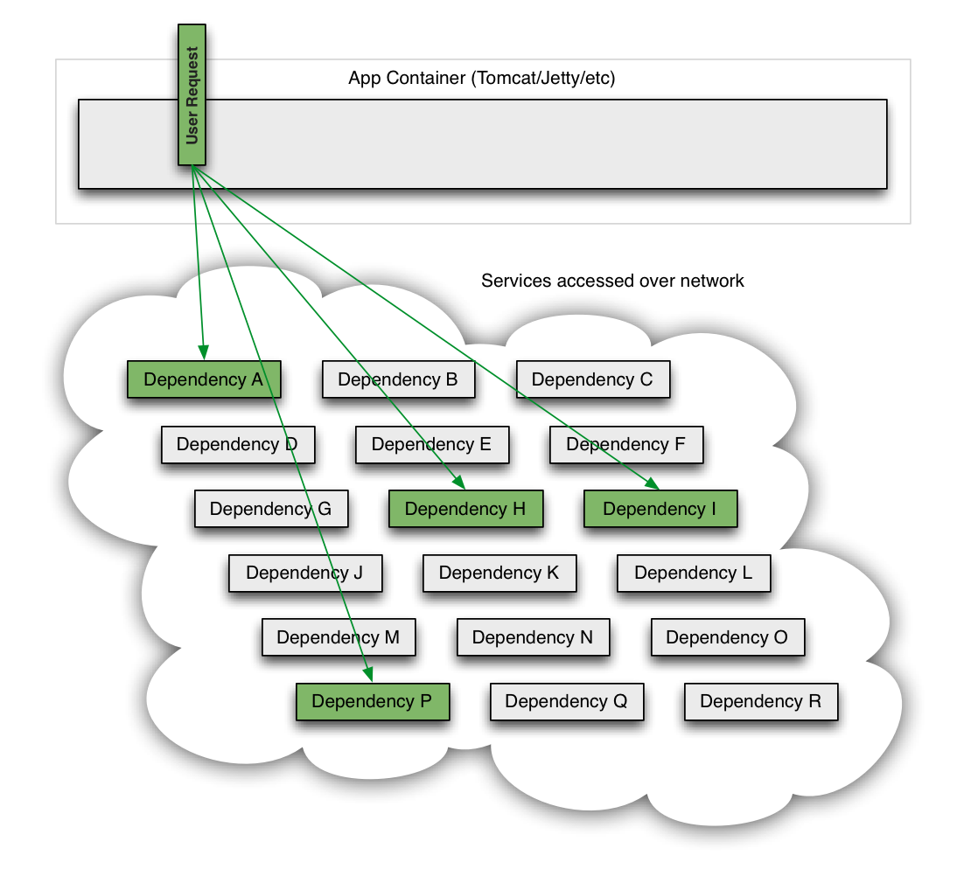
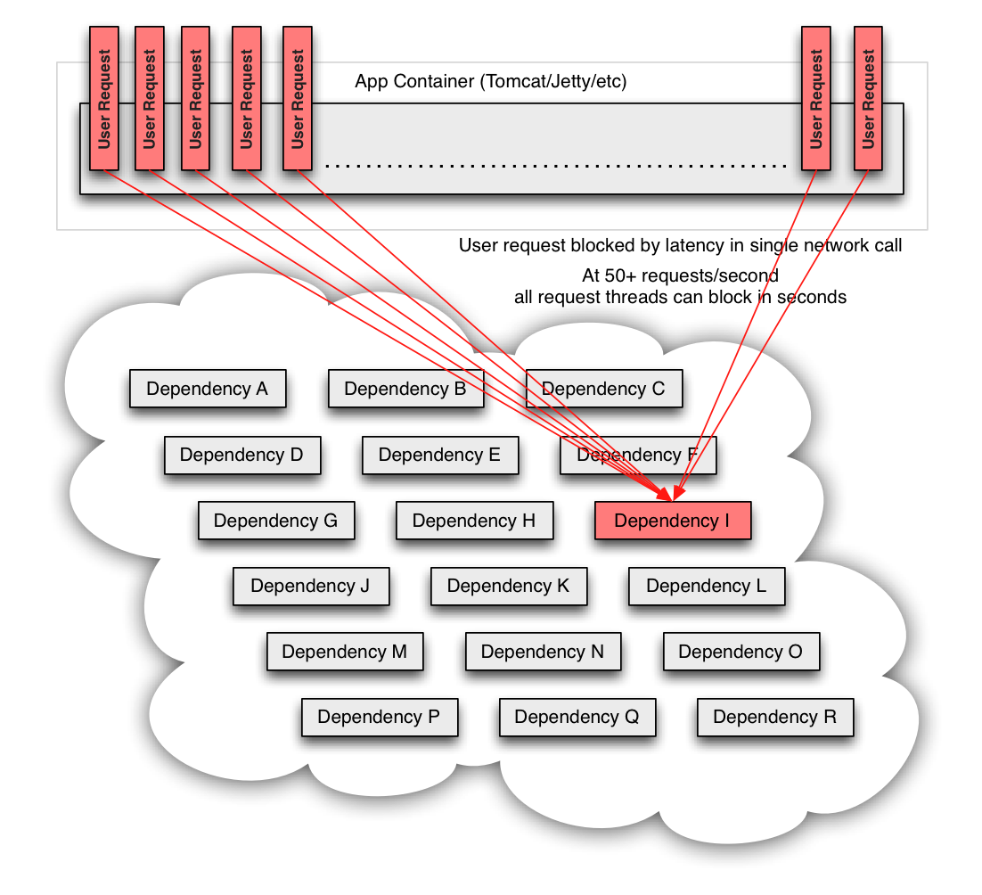
Fault tolerance
Non-blocking I/O
Message Queue

Slide 9
Sample

Slide 10
Architecture
High Available
Robust
Scalable
Low Latency
Fault Tolerant
User Friendly

Slide 11
Thanks

